Slide 1

PAC MAN (game)
[E2-6]
Foundations of Programming-CSE10010
Mini Project Presentation 2025-26
:Team Members:
Rahul Chatterjee(1262251741)
Shatakshi Shiravale(1262252433)
Ayushman Tripathi (1262253832)
Srishti Shrivastava(1262250775)
Samruddhi Raskar(1262253382)
:Guided By:
Prof. Shirish Paygude
Dr. Anushri Kulkarni

Slide 2
Content
Introduction and Motivation
Problem Statement and Objectives
Individual Contribution
Summary of Literature Survey
Proposed System
Hardware and Software Requirements
Implementation and Experimental Setup
Results and Conclusions
References

Slide 3
Introduction and Motivation
Classic arcade game Pac-Man recreated using C programming
Focus on understanding real-time input handling & game logic
Learn concepts:
Arrays (2D grid)
Pointers
File hadling
This project helps us understand how low-level programming can be used to build interactive systems.

Slide 4
Problem Statement and Objectives
Design a terminal-based Pac-Man game using C
Implement:
Player movement
Ghost AI behavior
Scoring system
Lives system
Leaderboard storage
Objectives
Implement real-time keyboard input
Use 2D arrays as game map
Apply pointer-based movement
Build basic AI for ghosts
Store player data using file handling

Slide 5
Individual Contribution
Name | Work (Report/Presentation/Algorithm Design/Implementation)
Shatakshi Shiravale | Player Movement
Shristi Shrivastava | Game State Update
Ayushman Tripathi | Grid System
Rahul Chatterjee | Ghost Movement
Samruddhi Rasker | Leaderboard

Slide 6
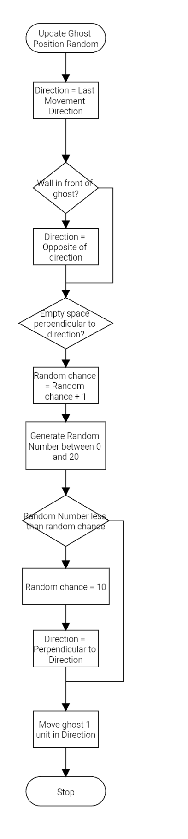
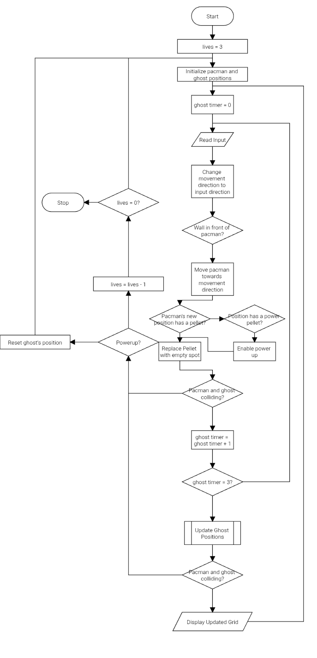
Proposed System
Detailed Description
Terminal-based grid (11x11 / 17x13)
Entities:
Pac-Man
Ghosts
Pellets
Power-ups
Controls:
W, A, S, D
Features:
Score tracking
Lives system
Leaderboard
Flowchart/ System Design

Slide 7
Hardware and Software Requirements
Hardware | Model | Justification w.r.t project
Basic PC/Laptop | Any | A computer is needed to run the project
Keyboard | Any | Keyboard Inputs are required
Software | Justification w.r.t project
Linux unix | Project uses linux based libraries such as unistd and termios
C compiler such as gcc | Project runs on C code

Slide 8
Implementation and Experimental Setup
Key functions
movement() → player movement
ghost_decide_dirn() → ghost AI
pac_update() → scoring
death_check() → collision
saveScore() → leaderboard
Experimental Setup
Game run in terminal
User inputs via keyboard
Real-time rendering using loop
Two modes: Easy & Hard
Different grid sizes

Slide 9
Results and Conclusion
Results
Game runs successfully
Score updates correctly
Ghost interaction works
Leaderboard stored in CSV
Conclusion
Successfully implemented Pac-Man in C
Learned:
Game logic
Memory handling
Real-time systems

Slide 10
References
Pac-Man game documentation
C programming resources

